Slide 1
Analysis of 2024 Election
Presented by : Ms .Rajesh Kushwah

Slide 2
Objective of this Project
The objective of this task is to analyze the 2024 election data to gain insights into the election results, party performance, and voter trends across various constituencies. I am use Power BI to create interactive visualizations and dashboards that will help stakeholders understand the election outcomes and the dynamics between different political alliances.

Slide 3
Data Description:
1. Election Results Data:
- `_id`: Unique identifier for each record.
- `State`: Name of the state.
- `Const. No.`: Constituency number.
- `Constituency`: Name of the constituency.
- `Leading Candidate`: Name of the leading candidate.
- `Leading Party`: Name of the leading party.
- `Trailing Candidate`: Name of the trailing candidate.
- `Trailing Party`: Name of the trailing party.
- `Margin`: Vote margin between the leading and trailing candidates.
- `Status`: Status of the election result (e.g., Won, Lost, Leading, Trailing).
2. Party Alliance Data:
- `Party Name`: Name of the political party.
- `Alliance Name`: Name of the political alliance the party belongs

Slide 4
Insight And Task

Slide 5
1. Data Integration: - Combine the election results data with the party alliance data to get a comprehensive view of which alliances are leading or trailing in various constituencies. 2. Data Cleaning and Preparation: - Ensure data quality by checking for missing values, inconsistencies, and correcting any errors in the datasets.

Slide 6
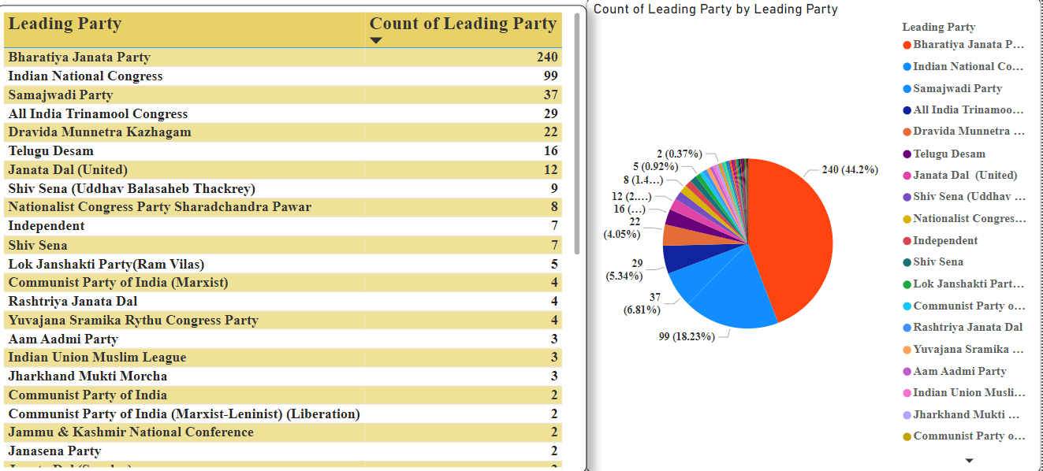
Create a summary of the overall election results including the total number of seats won by each party and alliance.

Slide 7
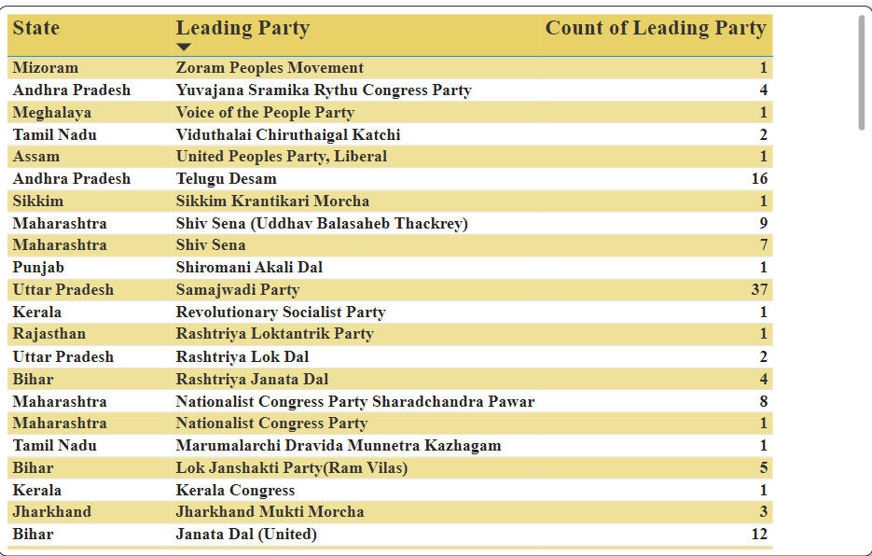
State-wise Analysis: Visualize the performance of leading parties and alliances across different states.

Slide 8
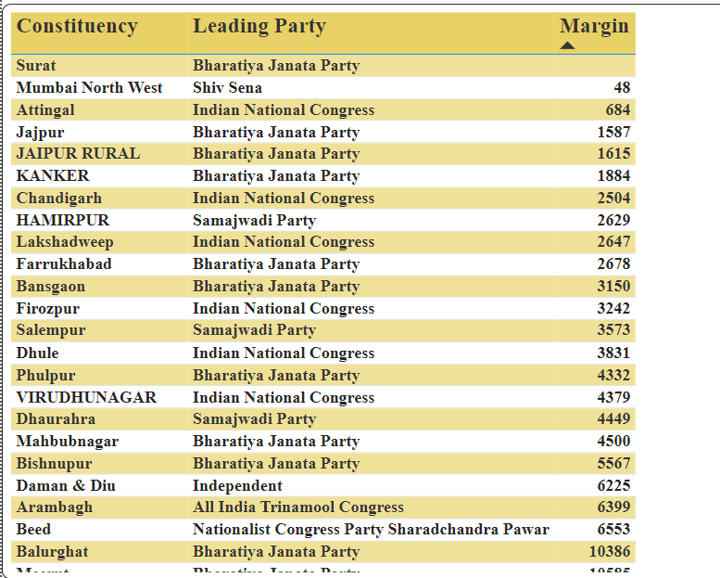
Constituency-wise Analysis: Analyze and visualize the margin of victory/defeat in various constituencies.

Slide 9
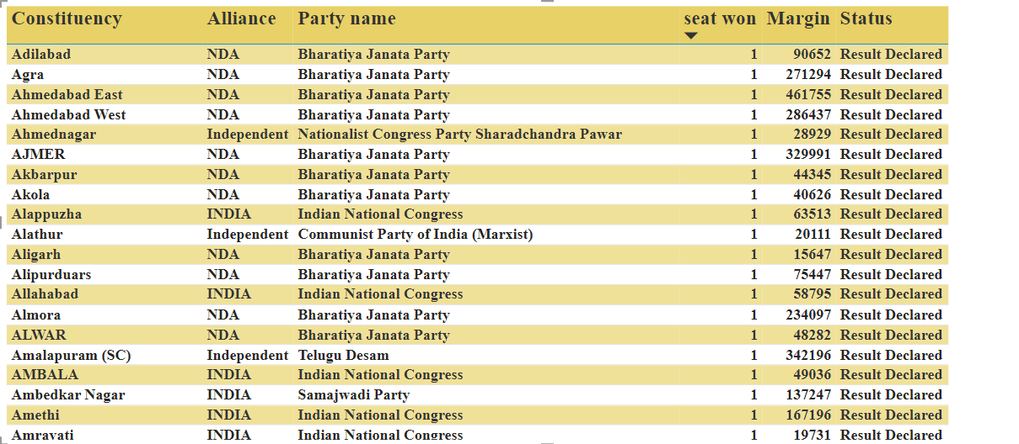
Party and Alliance Comparison: Compare the performance of different parties and their respective alliances in terms of seats won, margins, and status.

Slide 10
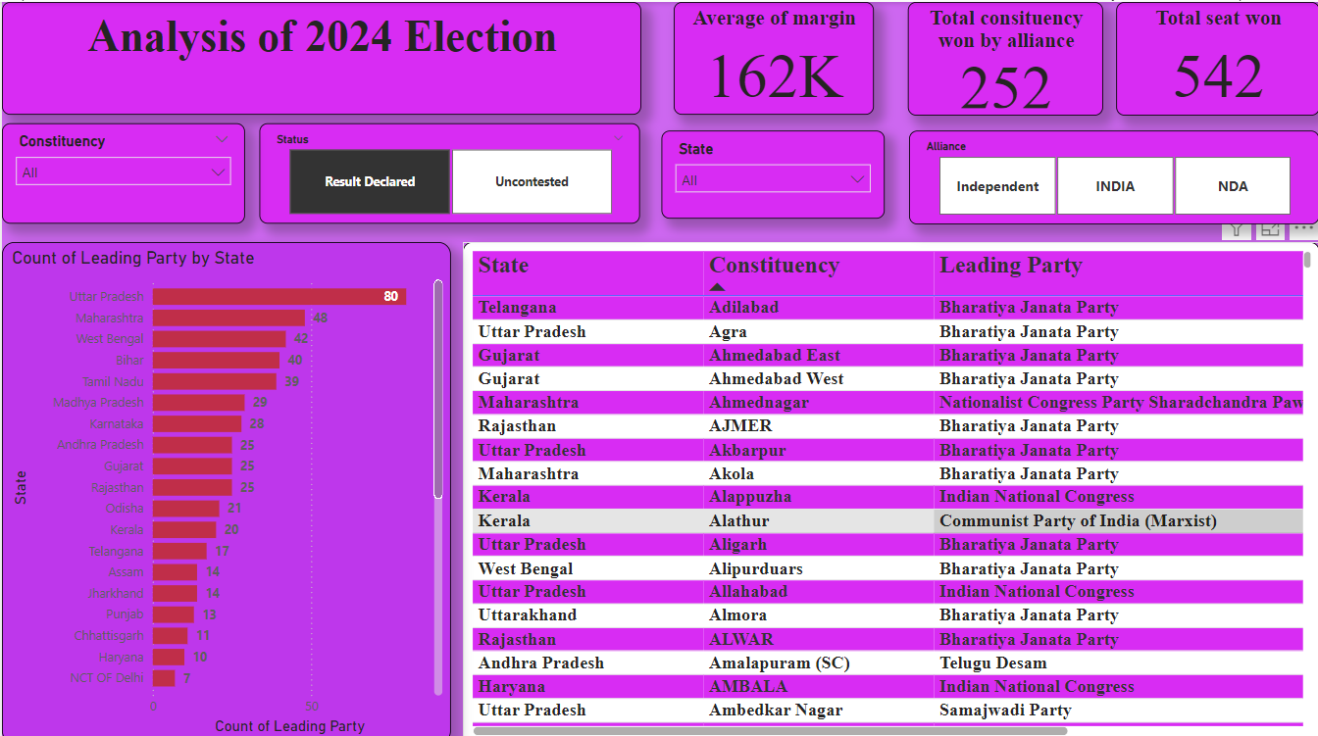

Slide 11
Insights
1.maximum seat take by BJP 240 and congres take seat only 99.
2.Total won seat is 543.
3.average margin is 162K
4.in M.P all seat won by BJP
5.in sikkim minimum seat won by BJP
6.There is three Alliance party INDEPENDENT,INDIA,NDA
7.BJP won the seat with the help of NDA is 253.

Slide 12
Recommendations
Sustain Engagement: Maintain the momentum of voter engagement by continuously addressing the issues that garnered support, particularly in rural areas. Implementing promised policies effectively will be crucial for retaining voter trust.
Expand Urban Appeal: To balance regional support, Alliance A should develop strategies to appeal more to urban voters, perhaps by addressing urban-specific issues such as public transportation, housing, and technology infrastructure.

Slide 13
THANK YOU

